Slide 1

Data Visualization and Reporting Tool
Mojtaba Ghasemi

Slide 2

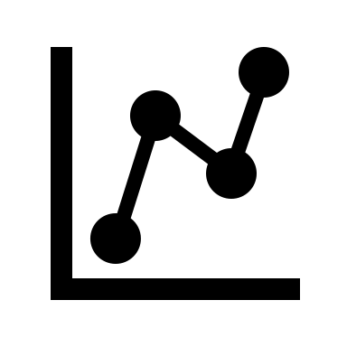



About me
Mojtaba Ghasemi
Senior Data Scientist
Ph.D. in Biomedical Engineering from University de Montreal
https://github.com/MJTGhasemi
https://ca.linkedin.com/in/mojtabaghasemi/
420-TT3-UM - Data Visualization and Reporting Tool | Montreal College IT

Slide 3
About you
- Background
- Enrolled program
- Highest education level
- Programming experience
420-TT3-UM - Data Visualization and Reporting Tool | Montreal College IT

Slide 4
Course Outline
- Data Foundation: Statistics
Descriptive Statistics
Introduction to Probability
Inferential Statistics
- Introduction to BI Solutions
Introduction to Business Intelligence
Introduction to Data Scientist
Introduction to Data Visualization
- Introducing Power BI and Power BI Services
Power BI Desktop
Designing Dashboards
Row-Level Security
- Power BI Data and Modeling
Transforming and Merging Data
Calculated Columns and Measures
420-TT3-UM - Data Visualization and Reporting Tool | Montreal College IT

Slide 5
Course Evaluations
- Assignments
25%
- Projects
25%
- Final Exam
50%
420-TT3-UM - Data Visualization and Reporting Tool | Montreal College IT

Slide 6
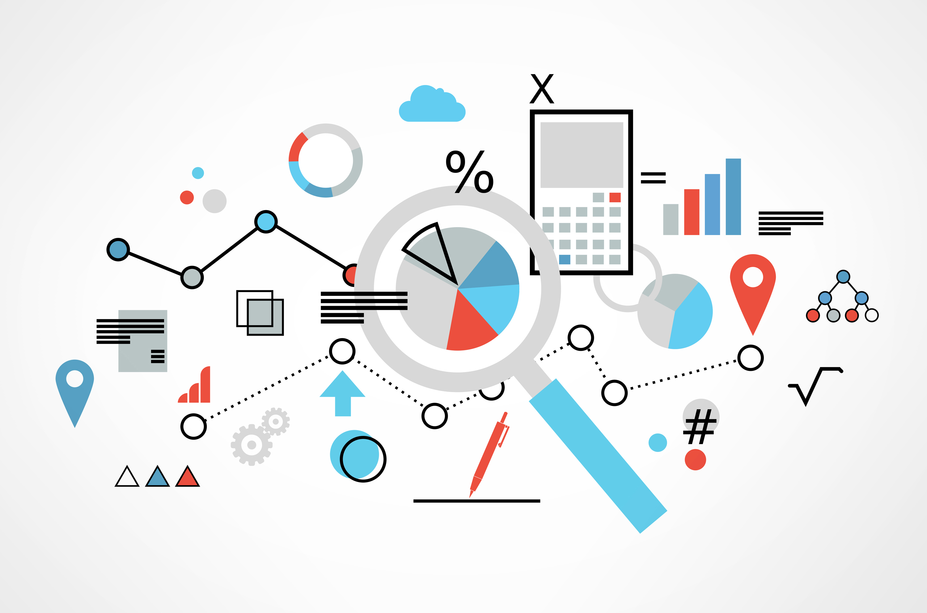
Data
Data refers to information gathered from different sources (sensor measurements, events, text, images, videos, etc.) through observations, measurements, research or analysis in order to provide:
Informed decision-making
Problem solving
Trend analysis
Performance measurement
Innovation
Personalization (tailor service to individual preferences)
Optimization
Risk management
Etc.
420-TT3-UM - Data Visualization and Reporting Tool | Montreal College IT

Slide 7
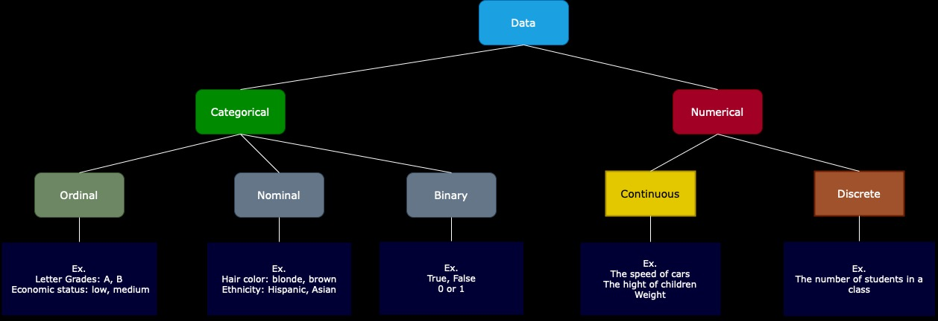
Data Types
Categorical: Data that can take on only a specific set of values representing a set of possible categories. (Synonyms: enums, enumerated, factors, nominal)
Binary: A special case of categorical data with just two categories of values, e.g., 0/1, true/false. (Synonyms: dichotomous, logical, indicator, boolean)
Ordinal: Categorical data that has an explicit ordering. (Synonym: ordered factor)
Nominal: represents discrete units and is used to label variables without providing any quantitative value or rank among categories
Numeric: Data that are expressed on a numeric scale.
Continuous: Data that can take on any value in an interval. (Synonyms: interval, float)
Discrete: Data that can take on only integer values, such as counts. (Synonyms: integer, count)
420-TT3-UM - Data Visualization and Reporting Tool | Montreal College IT

Slide 8
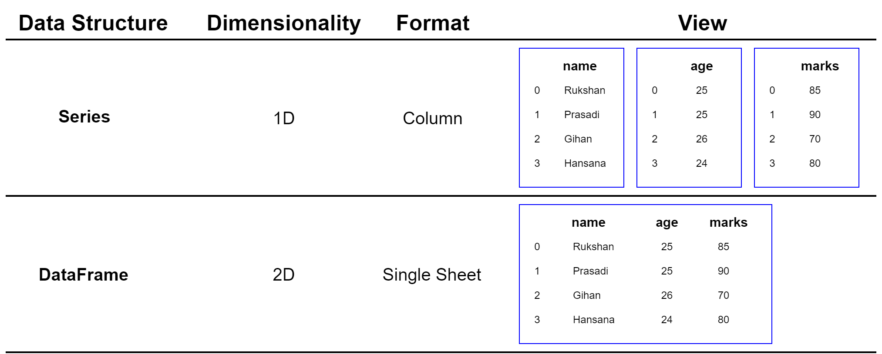
Data Structure
Series:
A Series is a one-dimensional labeled array capable of holding any data type. It is like a column in a table, ideal for representing one-dimensional data structures like a list of values.
DataFrame:
A two-dimensional labeled data structure with columns of potentially different types You can think of it like a spreadsheet or SQL table.
420-TT3-UM - Data Visualization and Reporting Tool | Montreal College IT

Slide 9
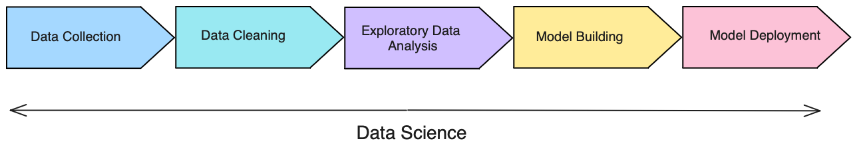
Understanding Data Cycle
- Data Collection: Aggregate and store data
- Data Cleaning: Data is usable and easily accessible
- Exploratory Data Analysis (EDA): Look for trends and high-level insights
- Model Building: Predict outcomes form the analysis
- Model Deployment: Make the model scalable for the business
420-TT3-UM - Data Visualization and Reporting Tool | Montreal College IT

Slide 10
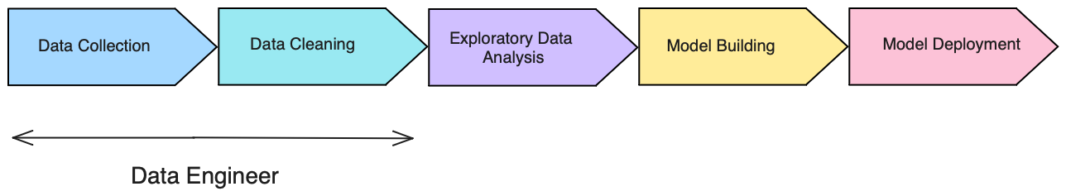
Understanding Data Cycle
Data Engineer:
Focuses on data collection and data cleaning
Strong SQL skills (pulling data and transforming it)
Extract, Transform, Load jobs (ETL)
Database maintenance techniques skills
420-TT3-UM - Data Visualization and Reporting Tool | Montreal College IT

Slide 11
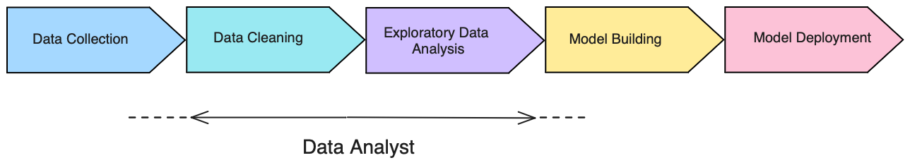
Understanding Data Cycle
Data / BI Analyst:
Focuses on data cleaning and EDA
Strong business intelligence skills (Excel, Power BI, Tableau)
Python, R skills
Do some data collection and model building tasks
420-TT3-UM - Data Visualization and Reporting Tool | Montreal College IT

Slide 12
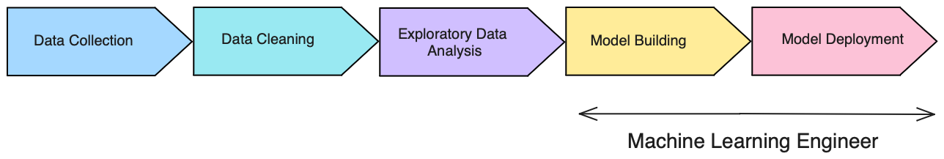
Understanding Data Cycle
Machine Learning Engineer (MLE):
Focuses on model building and putting models into production
Strong Python and other language (java, scala) skills
Strong understanding of ML tools and production environment
Software engineering skills
420-TT3-UM - Data Visualization and Reporting Tool | Montreal College IT

Slide 13
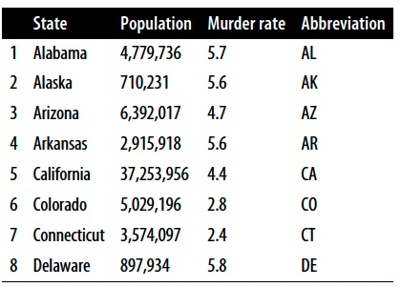
Statistics
What is statistics?
One of the best ways to get information from numerical data. It’s used to estimate or measure a parameter.
Why is statistics vital?
The important role of statistics is to represent unstructured data in the form of tables, graphs, and charts.
420-TT3-UM - Data Visualization and Reporting Tool | Montreal College IT

Slide 14
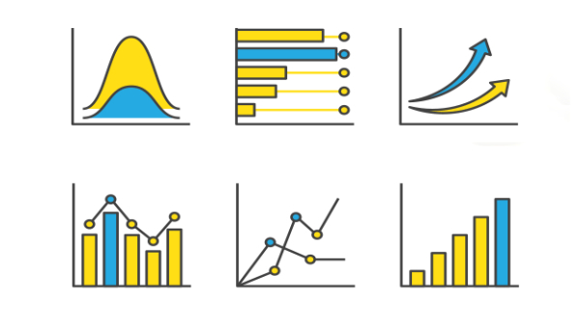
The important role of Statistics in Data Science
Statistics will provide a roadmap for the whole process of data science.
Statistics is one of the major parts of the data science field and helps us get better results from data, validating models and underlying patterns.
Statistics allows data scientists to quantify uncertainty and make predictions while accounting for randomness and variability in data.
Statistics enables decision-makers to derive insights from data through hypothesis testing, probability, and predictive modeling, leading to more informed and evidence-based decisions.
420-TT3-UM - Data Visualization and Reporting Tool | Montreal College IT

Slide 15
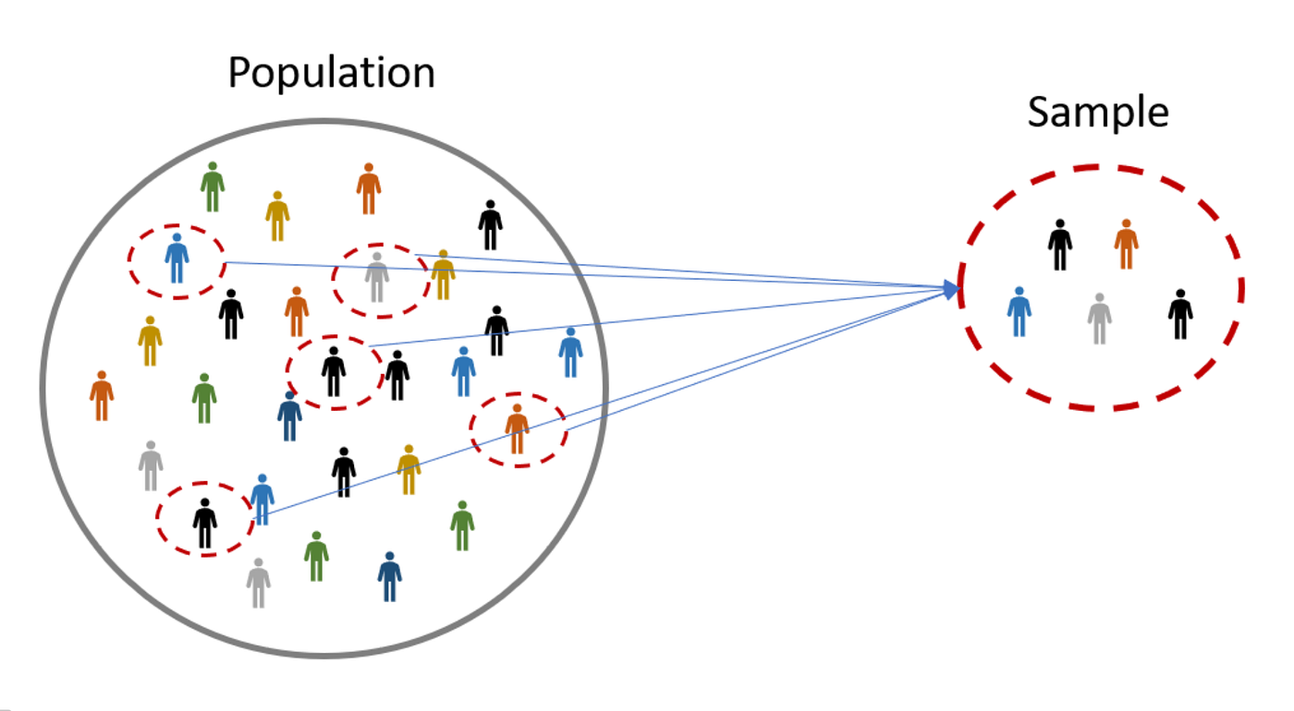
Sample & Population
Population: The entire group that you want to draw conclusions about.
Sample: A subset of the population that is used to represent the group.
420-TT3-UM - Data Visualization and Reporting Tool | Montreal College IT

Slide 16
Why Use a Sample
It is often impractical or impossible to study the whole population due to constraints of time, cost, and logistics.
Example of samples:
- A survey of 10,000 voters in a country.
- 50 trees selected from the forest for measurement.
- A group of 50 students chosen for a research study at an university
Random sampling:
Ensures that every member of the population has an equal chance of being selected, which helps to avoid bias and makes the sample representative of the population.
420-TT3-UM - Data Visualization and Reporting Tool | Montreal College IT

Slide 17
Random Sampling
Simple random sampling is a procedure in which
each member of the population is chosen strictly by chance
each member of the population is equally likely to be chosen
every possible sample of n objects is equally likely to be chosen
The resulting sample is called a random sample
420-TT3-UM - Data Visualization and Reporting Tool | Montreal College IT

Slide 18
Quiz: Identify the Sample and the Population
Scenario: A survey is conducted on 500 high school students about their eating habits.
Population: All high school students
Sample: The 500 high school students surveyed
Scenario: A company tests 30 out of its 500 software products for quality assurance.
Population: All 500 software products of the company
Sample: The 30 products tested
Scenario: In a city, a traffic study analyzes 200 randomly selected cars out of thousands during rush hour.
Population: All cars in the city during rush hour
Sample: The 200 cars selected for the study
Scenario: A researcher is studying the impact of a new teaching method on all the third-grade students in a school district.
Population: All third-grade students in the school district
Sample: A group of students
420-TT3-UM - Data Visualization and Reporting Tool | Montreal College IT

Slide 19
Descriptive and Inferential Statistics
Descriptive statistics
Collecting, summarizing, and processing data to transform data into information
Inferential statistics
Provide the basis for predictions, forecasts, and estimates that are used to transform information about samples into inferences about populations
420-TT3-UM - Data Visualization and Reporting Tool | Montreal College IT

Slide 20
Descriptive Statistics
Descriptive statistics involve summarizing and organizing and simplifying data in a way that provides meaningful information about a sample or population.
Types of Descriptive statistics:
Organizing Data
Tables
Graphs (Bar Charts, Histograms, Line Graphs, Pie Charts, Scatter Plots, Box Plots)
2. Summarizing Data
Measures of Central Tendency (Mean, Median, mode)
Measures of Variation (Range, Interquartile Range, Variance, Standard Deviation)
Measures of Shape (Skewness, Kurtosis)
Measures of Association (Covariance, Correlation)
420-TT3-UM - Data Visualization and Reporting Tool | Montreal College IT

Slide 21
Frequency Distribution of IQ for Employees
IQ | Frequency
82.00 | 1
87.00 | 1
89.00 | 1
93.00 | 1
96.00 | 2
97.00 | 1
102.00 | 1
103.00 | 1
105.00 | 1
109.00 | 1
115.00 | 2
119.00 | 1
120.00 | 1
127.00 | 1
131.00 | 2
140.00 | 1
144.00 | 3
162.00 | 1
Total | 24
Organizing Data
Tables:
Frequency Tables: Display the frequency of various outcomes in a sample.
Data Tables: Standard tables that represent data with rows and columns.
Age | Gender | Education Level | Job Title | Years of Experience
32 | Male | Bachelor’s | Software Engineer | 5
28 | Female | Master’s | Data Analyst | 3
45 | Male | PhD | Senior Manager | 15
36 | Female | Bachelor’s | Sales Associate | 7
420-TT3-UM - Data Visualization and Reporting Tool | Montreal College IT

Slide 22
Organizing Data
Age | Gender | Education Level | Job Title | Department | Years of Experience | Salary
32 | Male | Bachelor’s | Software Engineer | IT | 5 | 90000
28 | Female | Master’s | Data Analyst | Data | 3 | 65000
45 | Male | PhD | Senior Manager | Operations | 15 | 150000
36 | Female | Bachelor’s | Sales Associate | Sales | 7 | 60000
52 | Male | Master’s | Director | Operations | 20 | 200000
29 | Male | Bachelor’s | Marketing Analyst | Data | 2 | 55000
42 | Female | Master’s | Product Manager | Operations | 12 | 120000
31 | Male | Bachelor’s | Sales Manger | Sales | 4 | 80000
26 | Female | Bachelor’s | Marketing Coordinator | Marketing | 1 | 45000
38 | Male | PhD | Senior Scientist | Operations | 10 | 110000
29 | Male | Master’s | Software Developer | IT | 3 | 75000
48 | Female | Bachelor’s | HR Manager | Human Resources | 18 | 140000
35 | Male | Bachelor’s | Financial Analyst | Data | 6 | 65000
40 | Female | Master’s | Project Manager | Operations | 14 | 130000
27 | Male | Bachelor’s | Customer Service Rep | Operations | 2 | 40000
44 | Male | Bachelor’s | Operations Manager | Operations | 16 | 125000
33 | Female | Master’s | Marketing Manager | Marketing | 7 | 90000
39 | Male | PhD | Senior Engineer | IT | 12 | 115000
Example:
Dataset of 373 employees’ information from a software company
420-TT3-UM - Data Visualization and Reporting Tool | Montreal College IT

Slide 23
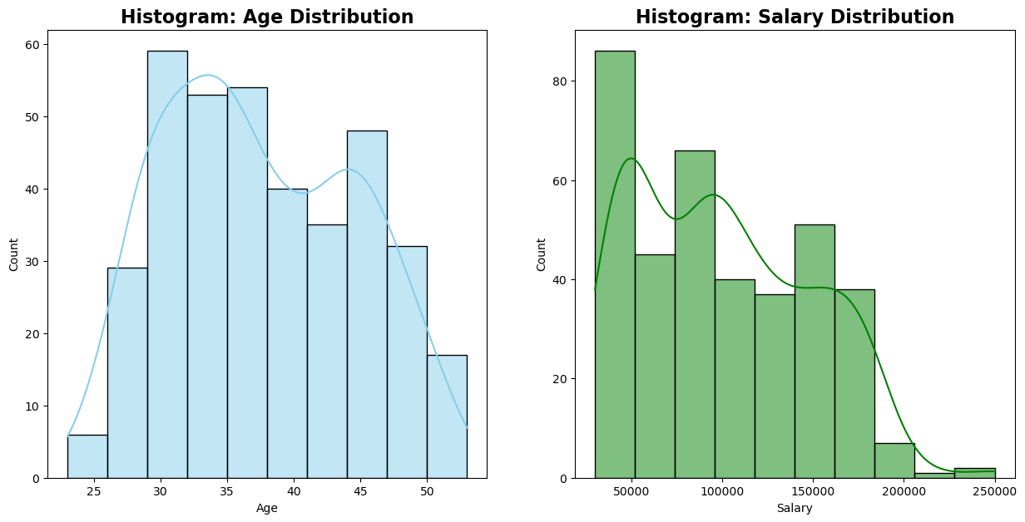
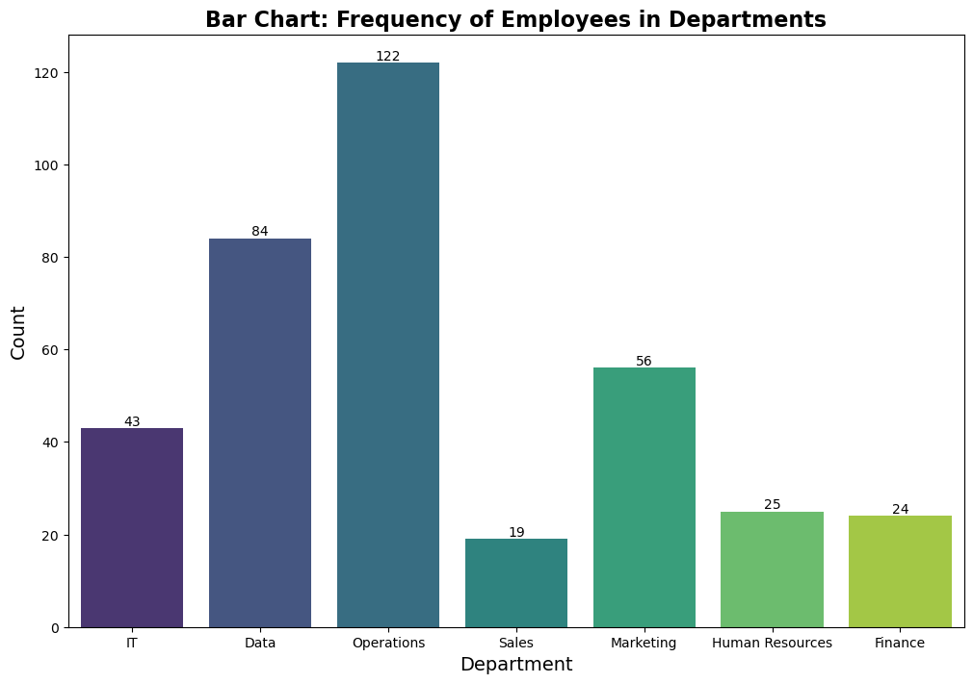
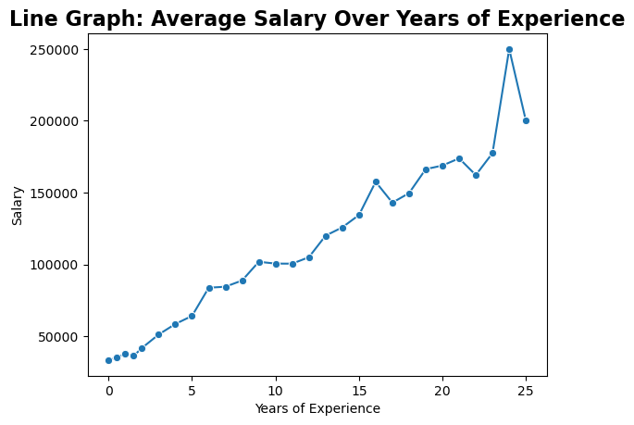
Organizing Data
Graphs:
420-TT3-UM - Data Visualization and Reporting Tool | Montreal College IT

Slide 24
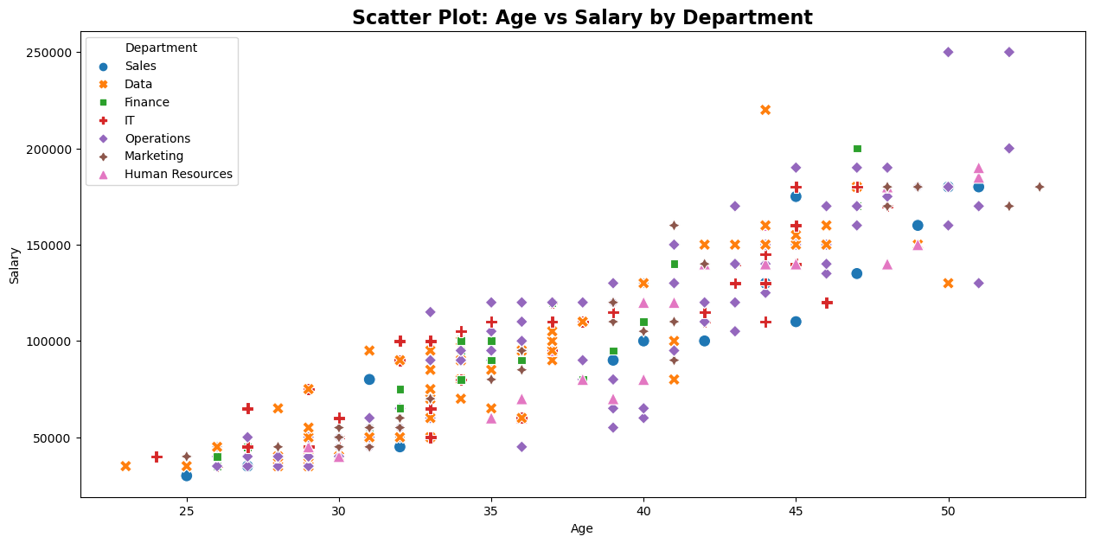
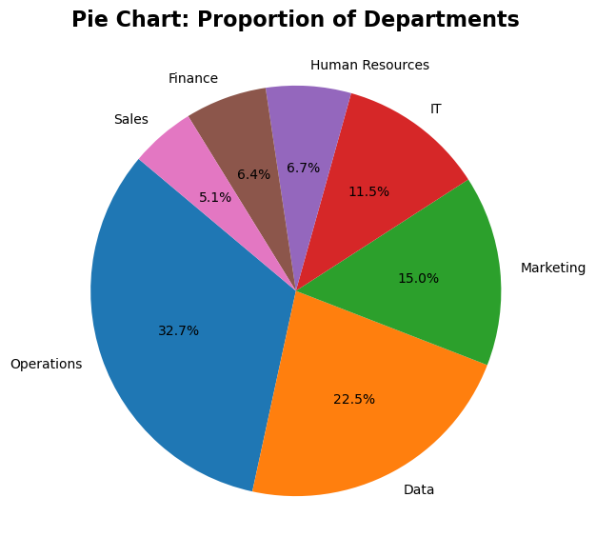
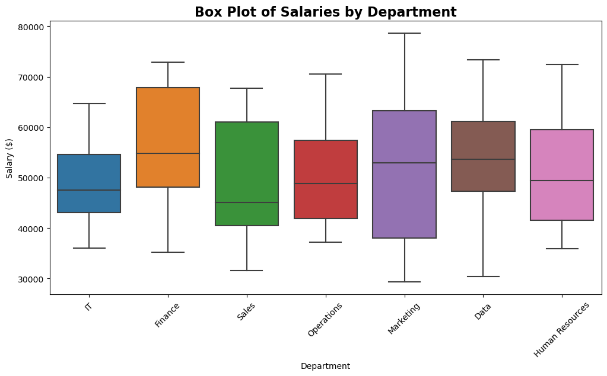
Organizing Data
Graphs:
420-TT3-UM - Data Visualization and Reporting Tool | Montreal College IT

Slide 25
Quiz: Identify the trends and insights from Graphs
Bar Chart:
The Operations department has the highest number of employees.
Sales has the least number of employees.
Histogram:
The Age Distribution histogram shows a roughly bell-shaped curve, but it's slightly right-skewed, indicating a larger number of employees in the middle to older age brackets.
The presence of the right tail in the Salary Distribution suggests that there are outliers or a small number of employees who earn much more than their colleagues.
Line Graph:
There is a general upward trend, indicating that salary increases with years of experience.
There is a significant spike in salary at around 25 years of experience. This could represent a few highly compensated individuals skewing the average or a specific promotion/compensation after 25 years that brings a substantial pay increase.
420-TT3-UM - Data Visualization and Reporting Tool | Montreal College IT

Slide 26
Quiz: Identify the trends and insights from Graphs
Pie Chart:
Scatter Plot:
Box Plot:
Send Your answers in the course channel before the start of next session
420-TT3-UM - Data Visualization and Reporting Tool | Montreal College IT

Slide 27
Graphs Presentation of Data
Categorical
Variables
Numerical
Variables
Frequency distribution
Bar chart
Pie chart
Line chart
Frequency distribution
Histogram
Scatter plot
Box plot
420-TT3-UM - Data Visualization and Reporting Tool | Montreal College IT

Slide 28
Summarizing Data
a. Measures of Central Tendency
Central tendency statistics provide insights into the center or typical value of a dataset, helping to understand where most data points cluster.
Let y denote a quantitative variable, with observations y₁ , y₂ , y₃ , … , y_{n}
- Median: Middle measurement or value in a sorted sample (50th Percentile)
- Mean: The average of all data point
- Mode: The most frequently occurring value(s) in a dataset
Why is it called the "measures of central tendency”?
420-TT3-UM - Data Visualization and Reporting Tool | Montreal College IT

Slide 29
Mean
Example:
Class A--IQs of 13 Students
102 115
128 109
131 89
98 106
140 119
93 97
110
Class B--IQs of 13 Students
127 162
131 103
96 111
80 109
93 87
120 105
109
Mean_{A} = $\frac{1437}{13}$ = 110.54 Mean_{B} = $\frac{1433}{13}$ = 110.23
420-TT3-UM - Data Visualization and Reporting Tool | Montreal College IT

Slide 30
Median
Class A--IQs of 13 Student (odd Number)
89
93
97
98
102
106
109
110
115
119
128
131
140
If the first student were to drop out of Class A
89
93
97
98
102
106
109
110
115
119
128
131
140
Example:
Median = 109
(six cases above, six below)
Median = 109.5
109 + 110 = 219/2 = 109.5
(six cases above, six below)
420-TT3-UM - Data Visualization and Reporting Tool | Montreal College IT

Slide 31
Properties of Mean and Median
For symmetric distributions, mean = median
Means can be badly affected by Outliers (data points with extreme values unlike the rest)
Median is unaffected by outliers, making it a better measure of central tendency
If the recorded values for a variable form a symmetric distribution, the median and mean are identical.
In skewed data, the mean lies further toward the skew than the median.
Symmetric (Normal)
Skewed
Mean
Median
Mean
Median
420-TT3-UM - Data Visualization and Reporting Tool | Montreal College IT

Slide 32
Mean and Median and Mode
Example:
New York Yankees baseball team, 2006
mean salary = $4.6 million
median salary = $2.8 million
mode = $1.9 million
How possible? Direction of skew?
Give an example for which you would expect
mean < median
Send Your answers in the course channel before the start of next session
420-TT3-UM - Data Visualization and Reporting Tool | Montreal College IT

Slide 33
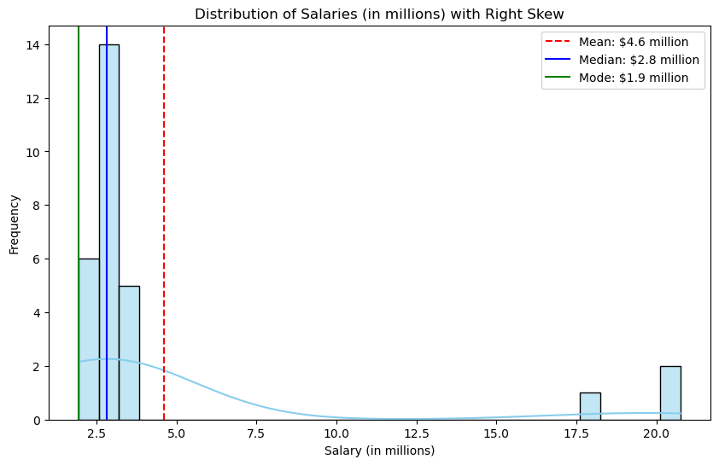
Mean and Median and Mode
Example:
New York Yankees baseball team, 2006
mean salary = $4.6 million
median salary = $2.8 million
mode = $1.9 million
How possible? Direction of skew?
Give an example for which you would expect
mean < median
Send Your answers in the course channel before the start of next session
420-TT3-UM - Data Visualization and Reporting Tool | Montreal College IT

Slide 34
Mode
Example:
Mode: The most common data point is called the mode.
The combined IQ scores for Classes A & B:
80 87 89 93 93 96 97 98 102 103 105 106 109 109 109 110 111 115 119 120 127
128 131 131 140 162
It is possible to have more than one mode!
A la mode!!
420-TT3-UM - Data Visualization and Reporting Tool | Montreal College IT

Slide 35
Symmetric (Normal)
Mode
In symmetric distributions, the mean, median, and mode are the same.
In skewed data, the mean and median lie further toward the skew than the mode.
Mean
Median
Mode
Skewed
Mode
Median
Mean
420-TT3-UM - Data Visualization and Reporting Tool | Montreal College IT

Slide 36
Takeaways
Mean: The mean, or average, is the sum of all values divided by the number of values. It's sensitive to outliers and provides a balanced representation of the dataset.
Median: The median is the middle value when the data is ordered. It's less affected by outliers and gives a better sense of the central value in skewed datasets.
Mode: The mode is the value that appears most frequently in the dataset. It can be helpful to for categorical data and is not affected by extreme values.
420-TT3-UM - Data Visualization and Reporting Tool | Montreal College IT

Slide 37
More on Distribution Shape
The shape of the distribution is said to be Symmetric (Normal) if the observations are balanced, or evenly distributed, about the center.
420-TT3-UM - Data Visualization and Reporting Tool | Montreal College IT

Slide 38
More on Distribution Shape
The shape of the distribution is said to be skewed if the observations are not symmetrically distributed around the center.
A positively skewed distribution (skewed to the right) has a tail that extends to the right in the direction of positive values.
A negatively skewed distribution (skewed to the left) has a tail that extends to the left in the direction of negative values.
420-TT3-UM - Data Visualization and Reporting Tool | Montreal College IT

Slide 39
Summarizing Data
b. Measures of Variation (Dispersion)
Dispersion statistics quantify the spread or variability of data points around a central value, helping to understand how data is distributed.
Range
Interquartile Range (IQR)
Variance
Standard Deviation
420-TT3-UM - Data Visualization and Reporting Tool | Montreal College IT

Slide 40
Range
The range is the difference between the maximum and minimum values in the dataset. It provides a simple measure of how widely the data is spread.
Example:
Let’s have this dataset: [78, 85, 92, 78, 88, 95, 82, 88, 90, 78]
Range Calculation:
To calculate the range, you subtract the smallest value from the largest value.
Largest value = 95, Smallest value = 78
Range = Largest value -Smallest value = 95 -78 = 17
So, for the given dataset, Range = 17
420-TT3-UM - Data Visualization and Reporting Tool | Montreal College IT

Slide 41
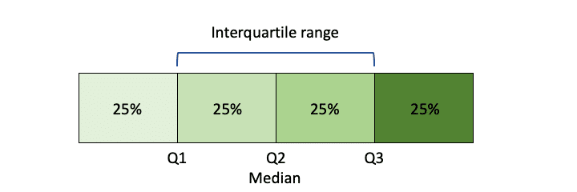
Interquartile Range (IQR)
IQR is the range between the first quartile (25th percentile) and the third quartile (75th percentile) of the data. It measures the spread of the middle 50% of the dataset, providing a robust measure less affected by outliers.
Example:
Let's calculate IQR for the dataset of exam scores: [78, 85, 92, 78, 88, 95, 82, 88, 90, 78]
Step 1: Order the Data
First, you need to order the data in ascending order: [78, 78, 78, 82, 85, 88, 88, 90, 92, 95]
Step 2: Calculate Quartiles
Find the median (Q2): (85 + 88) / 2 = 86.5 (average of the 5th and 6th values)
Find the lower quartile (Q1), which is the median of the lower half: 78
Find the upper quartile (Q3), which is the median of the upper half: 90
Step 3: Calculate IQR
IQR = Q3 - Q1 = 90 - 78 = 12
420-TT3-UM - Data Visualization and Reporting Tool | Montreal College IT

Slide 42
Interquartile Range (IQR)
Example:
Find the following for the “Salary” column of the “Employee_Salary” dataset
Min
Max
Q1
Median or Q2
Q3
IQR
Salary
30000
35000
35000
35000
35000
35000
35000
35000
40000
40000
45000
35000
35000
35000
35000
35000
35000
40000
40000
40000
45000
45000
Manual
420-TT3-UM - Data Visualization and Reporting Tool | Montreal College IT

Slide 43
Interquartile Range (IQR)
Example:
Find the following for the “Salary” field of the “Employee_Salary” dataset
Microsoft Excel
Min = MIN(G2:G374)
Max = Max(G2:G374)
Mean = AVERAGE(G2:G374)
Median = MEDIAN(G2:G374)
Mode = MODE.SNGL(G2:G374)
Q1 = PERCENTILE(G2:G374, 0.25)
Q3 = PERCENTILE(G2:G374, 0.75)
IQR = Q3 – Q1
Python
salary_min = df['Salary'].min()
salary_max = df['Salary'].max()
salary_mean = df['Salary'].mean()
salary_median = df['Salary'].median()
salary_mode = df['Salary'].mode()
Q1 = df['Salary'].quantile(0.25)
Q3 = df['Salary'].quantile(0.75)
IQR = Q3 - Q1
420-TT3-UM - Data Visualization and Reporting Tool | Montreal College IT

Slide 44
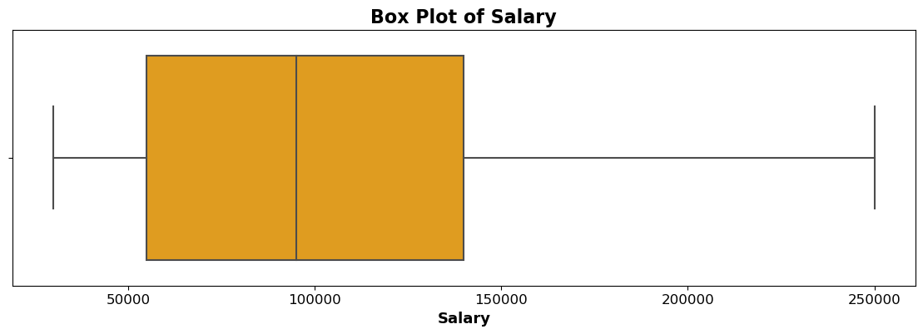
Interquartile Range (IQR)
Example:
Find the following for the “Salary” field of the “Employee_Salary” dataset
Q1 = 55000
Max = 250000
Min = 30000
Median = 95000
Q3 = 140000
420-TT3-UM - Data Visualization and Reporting Tool | Montreal College IT

Slide 45
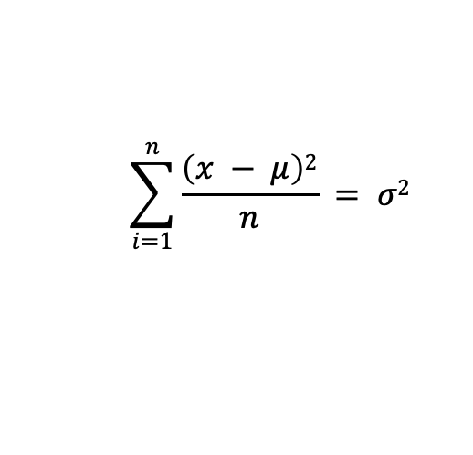
Variance
The variance measures how much individual data points deviate from the mean. It involves squaring the differences between each data point and the mean, summing those squares, and then dividing by the number of data points.
Step 1
78
78
78
82
85
88
88
90
92
95
85.4
Step 2
78 – 85.4 | -7.4
78 – 85.4 | -7.4
78 – 85.4 | -7.4
82 – 85.4 | -3.4
85 – 85.4 | -0.4
88 – 85.4 | 2.6
88 – 85.4 | 2.6
90 – 85.4 | 4.6
92 – 85.4 | 6.6
95 – 85.4 | 9.6
Step 3
(-7.4)² | 54.76
(-7.4)² | 54.76
(-7.4)² | 54.76
(-3.4)² | 11.56
(-0.4)² | 0.16
(2.6)² | 6.76
(2.6)² | 6.76
(4.6)² | 21.16
(6.6)² | 43.56
(9.6)² | 92.16
Step 4
54.76
54.76
54.76
11.56
0.16
6.76
6.76
21.16
43.56
92.16
34.46
$$\sum_{i=1}^{n}{\frac{\left(x − μ\right)2}{n}} = σ2$$
Mean
Mean
= Variance
420-TT3-UM - Data Visualization and Reporting Tool | Montreal College IT

Slide 46
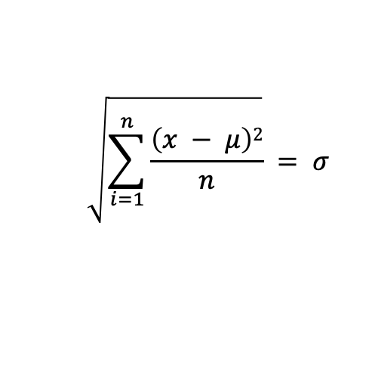
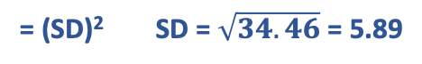
Standard Deviation (SD)
The standard deviation is the square root of the variance. It indicates the average deviation of data points from the mean. A higher standard deviation implies greater dispersion.
Step 1
78
78
78
82
85
88
88
90
92
95
85.4
Step 2
78 – 85.4 | -7.4
78 – 85.4 | -7.4
78 – 85.4 | -7.4
82 – 85.4 | -3.4
85 – 85.4 | -0.4
88 – 85.4 | 2.6
88 – 85.4 | 2.6
90 – 85.4 | 4.6
92 – 85.4 | 6.6
95 – 85.4 | 9.6
Step 3
(-7.4)² | 54.76
(-7.4)² | 54.76
(-7.4)² | 54.76
(-3.4)² | 11.56
(-0.4)² | 0.16
(2.6)² | 6.76
(2.6)² | 6.76
(4.6)² | 21.16
(6.6)² | 43.56
(9.6)² | 92.16
Step 4
54.76
54.76
54.76
11.56
0.16
6.76
6.76
21.16
43.56
92.16
34.46
$$\sqrt{\sum_{i=1}^{n}{\frac{\left(x − μ\right)2}{n}}} = σ$$
Step 5
Mean
Mean
= (SD)² SD = $\sqrt{34.46}$ = 5.89
420-TT3-UM - Data Visualization and Reporting Tool | Montreal College IT

Slide 47
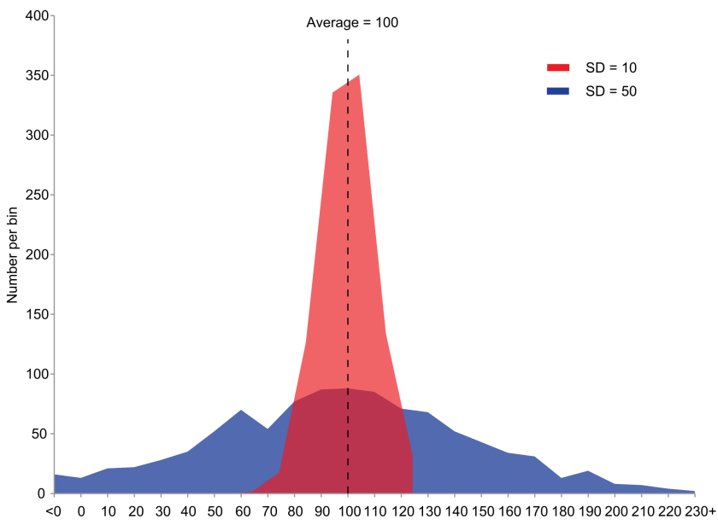
What does the SD tell us?
The standard deviation is a measure of the amount of variation or dispersion present in a dataset.
It quantifies how spread out the data points are from the mean value.
A higher standard deviation indicates greater variability among the data points, while a smaller standard deviation indicates that the data points are closely clustered around the mean
420-TT3-UM - Data Visualization and Reporting Tool | Montreal College IT

Slide 48
Variance vs. Standard Deviation
The standard deviation is measured in the same units as the original data, making it more intuitive to understand and interpret.
Variance, being in squared units, can be less straightforward to grasp.
The standard deviation is less sensitive to extreme values.
Aspect | Variance | Standard Deviation
Calculation | Average of squared differences from the mean | Square root of the variance
Units | Squared units (e.g., squared meters, squared USD) | Same units as the original data
Interpretation | Gives an idea of the spread of data | Provides a clearer measure of spread
Sensitivity to Data | Sensitive to extreme values (squares differences) | Less sensitive (square root reduces impact)
Magnitude | Larger values, less intuitive interpretation | Smaller values, easier to interpret
Comparison | Harder to compare between different datasets | Easier to compare across datasets
420-TT3-UM - Data Visualization and Reporting Tool | Montreal College IT

Slide 49
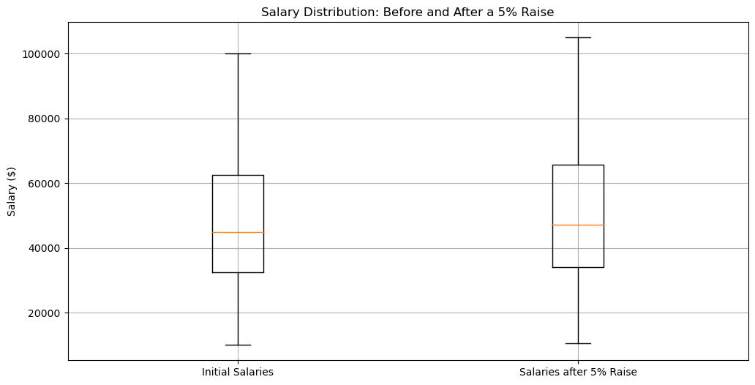
Assignment for Variance and SD
Refer to the Word file for details.
Position | Salary
President | $100,000
Manager | $50,000
Secretary | $40,000
Maintenance Worker | $10,000
420-TT3-UM - Data Visualization and Reporting Tool | Montreal College IT

Slide 50
Descriptive Statistics
Descriptive statistics involve summarizing and organizing and simplifying data in a way that provides meaningful information about a sample or population.
Types of Descriptive statistics:
Organizing Data
Tables
Graphs (Bar Charts, Histograms, Line Graphs, Pie Charts, Scatter Plots, Box Plots)
2. Summarizing Data
Measures of Central Tendency (Mean, Median, mode)
Measures of Variation (Range, Interquartile Range, Variance, Standard Deviation)
Measures of Shape (Skewness, Kurtosis)
Measures of Association (Covariance, Correlation)
420-TT3-UM - Data Visualization and Reporting Tool | Montreal College IT

Slide 51
Summarizing Data
c. Measures of Shape
Skewness is the tendency of the deviations from the mean to be larger in one direction than in the other. Tendency for one tail of the distribution to be heavier than the other.
Kurtosis is a measure of the relative peakedness or flatness of the frequency distribution curve. The kurtosis of a normal distribution is zero.
420-TT3-UM - Data Visualization and Reporting Tool | Montreal College IT

Slide 52
Skewness and Kurtosis
The measures of central tendencies obtain a representative value of the data.
The measures of variance help us to know that whether most of the data points are close to or away from the measures of central tendencies.
But these measure are not sufficient to interpret data. Another aspect of the data is to know its symmetry and flatness (Skewness and Kurtosis).
420-TT3-UM - Data Visualization and Reporting Tool | Montreal College IT

Slide 53
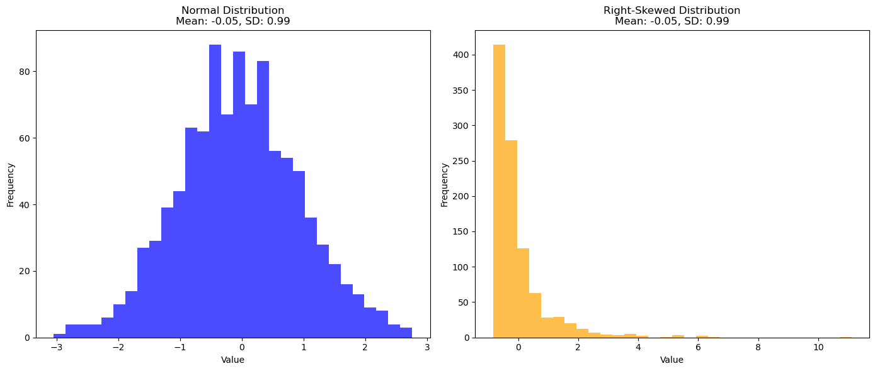
Importance of Skewness
Is it possible that two distributions have the same mean and standard deviations, but they are not similar in distribution? How?
420-TT3-UM - Data Visualization and Reporting Tool | Montreal College IT

Slide 54
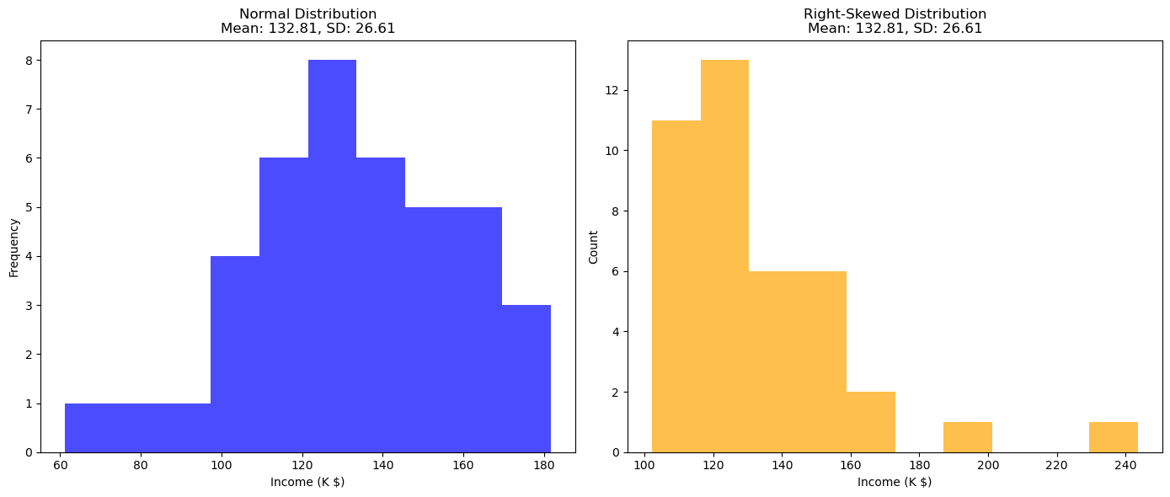
Importance of Skewness
Why is Skewness important?
Example: Income distribution is often skewed, affecting economic policies. A right-skewed income distribution might indicate a large proportion of the population earning below the mean income, which has implications for welfare and taxation policies.
420-TT3-UM - Data Visualization and Reporting Tool | Montreal College IT

Slide 55
Importance of Skewness
It is crucial to consider the differences in shape and spread of two data sets that have the same mean and standard deviation.
Misleading summary statistics
Consider an investment portfolio. Two portfolios may have the same average return (mean) and risk (standard deviation), but one might have consistent returns, while the other might have highly variable returns with occasional large gains or losses. Without understanding the shape of the return distribution, an investor might make an uninformed choice.
Impact on decision making
In healthcare, suppose two treatments have the same average effectiveness (mean) and variability (SD). However, one treatment could have a right-skewed distribution, indicating that it is highly effective for some but less so for many. The other might have a normal distribution, offering moderate effectiveness uniformly.
420-TT3-UM - Data Visualization and Reporting Tool | Montreal College IT

Slide 56
Importance of Skewness
It is crucial to consider the differences in shape and spread of two data sets that have the same mean and standard deviation.
Applicability of statistical tests
In psychology, tests like t-tests assume normal distribution. If data is skewed, these tests might give inaccurate results. For example, analyzing survey data (like satisfaction scores) might require non-parametric tests if the data is not normally distributed.
420-TT3-UM - Data Visualization and Reporting Tool | Montreal College IT

Slide 57
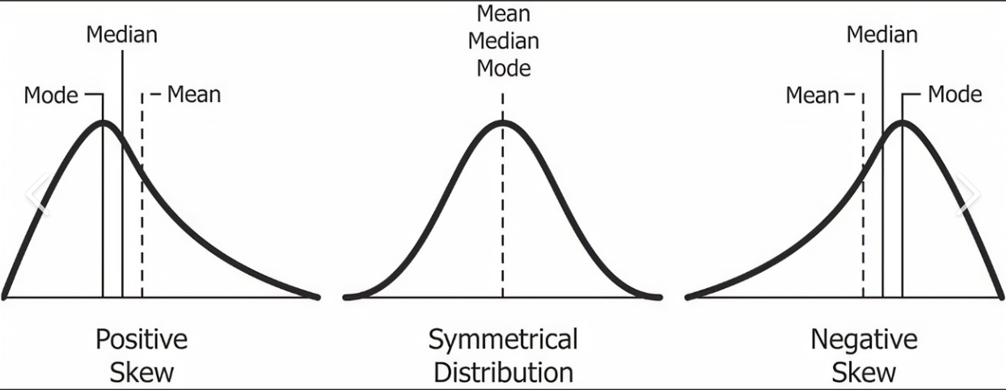
Skewness Takeaways
420-TT3-UM - Data Visualization and Reporting Tool | Montreal College IT

Slide 58
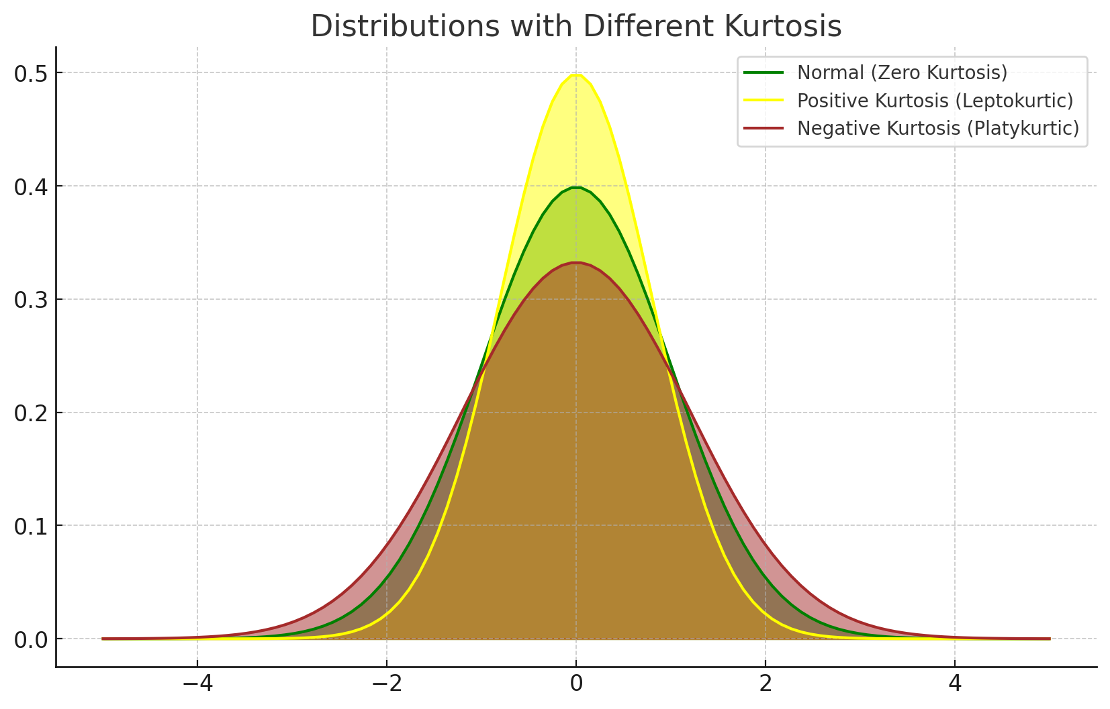
Kurtosis
Kurtosis refers to the degree of flatness or peakedness which is measured relative to the peakedness of normal curve.
420-TT3-UM - Data Visualization and Reporting Tool | Montreal College IT

Slide 59
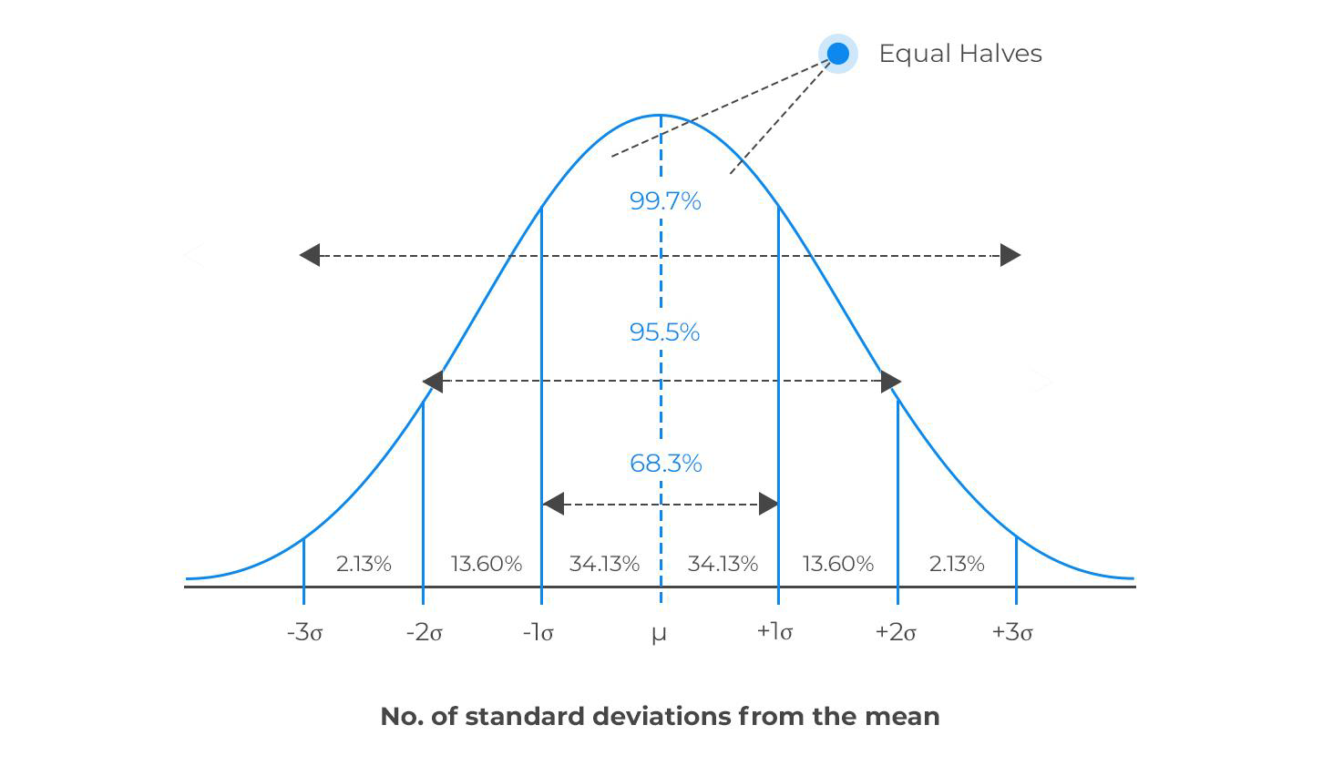
Normal Distribution
The normal distribution, or Gaussian distribution, is one of the most important and widely used probability distributions in statistics and probability theory.
The normal distribution is used in various applications because it approximates the distribution of many naturally occurring phenomena, such as heights, test scores, measurement errors, and IQ scores.
It is also fundamental in statistical hypothesis testing, confidence interval estimation, and data analysis.
420-TT3-UM - Data Visualization and Reporting Tool | Montreal College IT

Slide 60
Normal Distribution Characteristics
Key characteristics of the normal distribution are:
Symmetry: The normal distribution is symmetric around its mean (average). This means that the curve is perfectly balanced, and the mean, median, and mode of the distribution are all equal and located at the centerof the curve.
Bell-shaped: The normal distribution curve is bell-shaped, with the highest point (the peak) occurring at the mean.
Continuous: The normal distribution is a continuous probability distribution, meaning it can take any real value within its range.
Parameters: The normal distribution is fully characterized by two parameters: the mean (μ) and the standard deviation (σ).
Empirical Rule: The normal distribution follows the empirical rule, also known as the 68-95-99.7 rule, which states that approximately 68% of the data falls within one standard deviation of the mean, 95% falls within two standard deviations, and 99.7% falls within three standard deviations.
420-TT3-UM - Data Visualization and Reporting Tool | Montreal College IT

Slide 61
Descriptive Statistics
Descriptive statistics involve summarizing and organizing and simplifying data in a way that provides meaningful information about a sample or population.
Types of Descriptive statistics:
Organizing Data
Tables
Graphs (Bar Charts, Histograms, Line Graphs, Pie Charts, Scatter Plots, Box Plots)
2. Summarizing Data
Measures of Central Tendency (Mean, Median, mode)
Measures of Variation (Range, Interquartile Range, Variance, Standard Deviation)
Measures of Shape (Skewness, Kurtosis)
Measures of Association (Covariance, Correlation)
420-TT3-UM - Data Visualization and Reporting Tool | Montreal College IT

Slide 62
Summarizing Data
d. Measures of Association
So far, we have been analyzing summary statistics that describe aspects of a single list of numbers. Frequently, however, we are interested in how variables behave together.
Covariance and Correlation are statistical tools used to measure the relationship between two variables.
They help us understand whether variables move together or in opposite directions.
420-TT3-UM - Data Visualization and Reporting Tool | Montreal College IT

Slide 63

Covariance
Covariance is a measure that indicates the extent to which two variables change together.
A positive value means that if one variable increases, the other tends to increase as well. A negative value indicates the opposite. The covariance values range from -∞ to +∞.
Example: Ice cream sales and temperature. As temperature increases (hotter days), ice cream sales increase, indicating a positive covariance.
420-TT3-UM - Data Visualization and Reporting Tool | Montreal College IT

Slide 64
Covariance
Covariance values are not standardized and can range from negative to positive infinity.
Because of this, it's hard to understand the strength of the relationship from covariance alone.
420-TT3-UM - Data Visualization and Reporting Tool | Montreal College IT

Slide 65
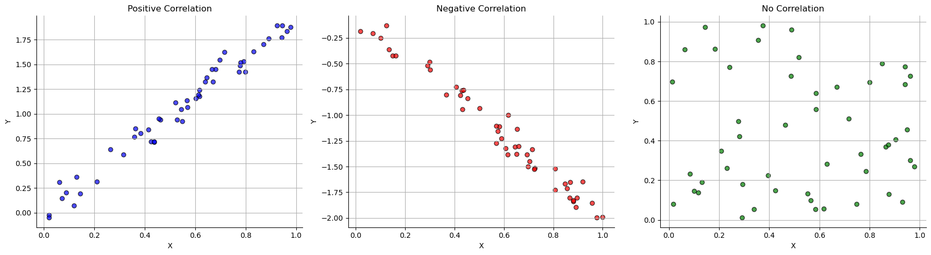
Correlation
Correlation also measures the strength and direction of the relationship between two variables.
Unlike covariance, correlation values are standardized between -1 and 1.
A correlation of 1 means a perfect positive relationship, -1 means a perfect negative relationship, and 0 means no relationship.
420-TT3-UM - Data Visualization and Reporting Tool | Montreal College IT

Slide 66
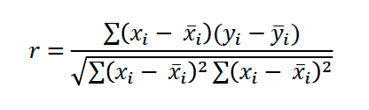
Correlation
Think of correlation as a standardized score that tells you if variables like to move together, in opposite directions, or act independently of each other.
Example: Studying and grades. Generally, as studying increases, grades tend to increase, suggesting a positive correlation.
To measure correlation, we can calculate the Pearson Correlation Coefficient.
420-TT3-UM - Data Visualization and Reporting Tool | Montreal College IT

Slide 67
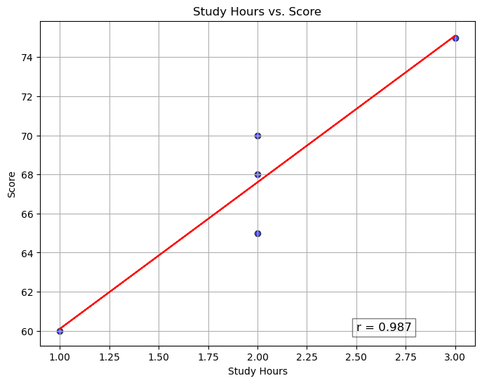
Pearson Correlation Coefficient
Study Hours | Score
2 | 65
3 | 75
1 | 60
4 | 85
2 | 70
5 | 90
3 | 75
4 | 80
2 | 68
6 | 95
r = | 0.987
Example:
420-TT3-UM - Data Visualization and Reporting Tool | Montreal College IT

Slide 68
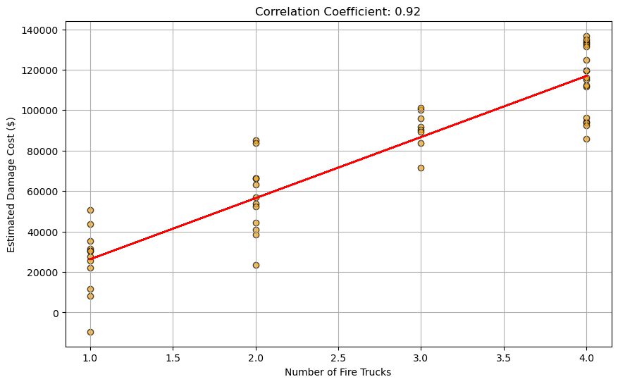
Correlation and Causation
Just because two variables are correlated does not mean one causes the other to happen.
Example: The number of fire trucks at a scene and the damage caused by the fire are correlated, but more fire trucks do not cause more damage.
Note: To model this relationship, we need regression.
420-TT3-UM - Data Visualization and Reporting Tool | Montreal College IT

Slide 69
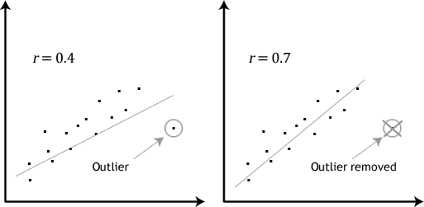
Correlation and Outliers
Correlation is sensitive to outliers.
We need to manage outliers before correlation calculation.
420-TT3-UM - Data Visualization and Reporting Tool | Montreal College IT

Slide 70
Types of Correlation
We have other correlation, depending on the dataset and analysis:
Correlation | Feature | Example
Pearson | Numerical vs. Numerical | Age and blood pressure
Spearman | At least one of the variable is categorical | IQ and TV viewing hours
Kendall | At least one of the variable is categorical | Customer satisfaction and employee training level
420-TT3-UM - Data Visualization and Reporting Tool | Montreal College IT

Slide 71
Descriptive Statistics
Descriptive statistics involve summarizing and organizing and simplifying data in a way that provides meaningful information about a sample or population.
Types of Descriptive statistics:
Organizing Data
Tables
Graphs (Bar Charts, Histograms, Line Graphs, Pie Charts, Scatter Plots, Box Plots)
2. Summarizing Data
Measures of Central Tendency (Mean, Median, mode)
Measures of Variation (Range, Interquartile Range, Variance, Standard Deviation)
Measures of Shape (Skewness, Kurtosis)
Measures of Association (Covariance, Correlation)
420-TT3-UM - Data Visualization and Reporting Tool | Montreal College IT

Slide 72
Regression
Regression is a statistical method used to model the relationship between a dependent variable (often denoted as "Y") and one or more independent variables (often denoted as "X").
It aims to understand how changes in the independent variable(s) affect the dependent variable.
Many types of relationships can be modeled with regression:
Simple linear regression
Multiple linear regression
Polynomial regression
Logistic Regression
420-TT3-UM - Data Visualization and Reporting Tool | Montreal College IT

Slide 73
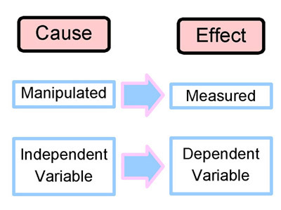
Dependent and Independent Variables
Independent variables:
The independent variable is the "cause" or "manipulated factor."
Example: Study hours in our example.
Dependent variables:
The dependent variable is the variable being studied or measured in an experiment or analysis (" Effect”).
Example: Exam scores in our example.
420-TT3-UM - Data Visualization and Reporting Tool | Montreal College IT

Slide 74
Simple Linear Regression
Simple linear regression is one of the most common types of regression.
In simple linear regression, there is one independent variable, and the relationship between variables is represented by a straight line (linear equation).
In simple linear regression, we try to model the following relationship:
𝑦=𝑎𝑥+𝑏
a: slope of the line
b: the y-intercept
420-TT3-UM - Data Visualization and Reporting Tool | Montreal College IT

Slide 75
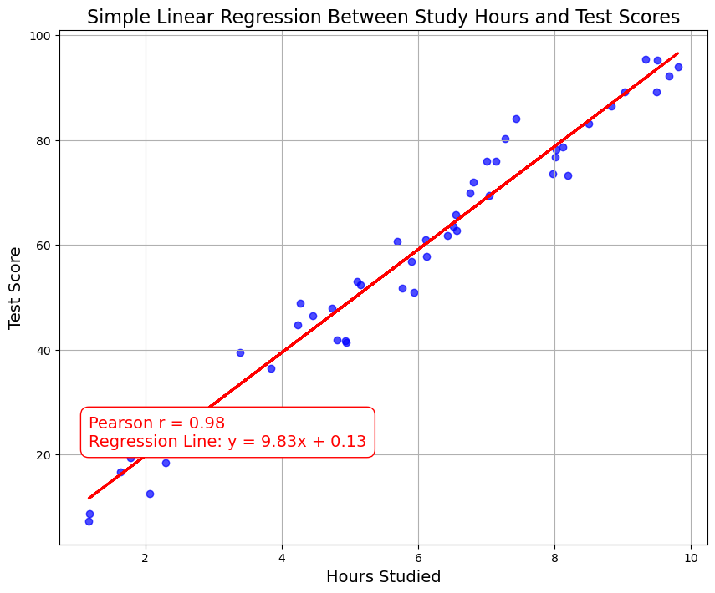
Simple Linear Regression
Example:
Simple Linear Regression between Study hours and Test scores
What are independent and dependent variables?
420-TT3-UM - Data Visualization and Reporting Tool | Montreal College IT

Slide 76
Correlation vs. Regression
 | Correlation | Simple Linear Regression
Purpose | Measure the strength and direction of the linear relationship between two continuous variables. | Model and predict the dependent variable (Y) based on the independent variable (X) in a linear relationship.
Type of Variables | Requires two continuous variables (X and Y). | Requires two continuous variables (X and Y).
Range of Values | Ranges from -1 to 1. | Coefficient (slope) can range from negative infinity to positive infinity.
Equation | No specific equation; measures correlation coefficient (r). | Uses a linear equation (Y = a + bX) to model the relationship.
Causation Inference | Correlation does not imply causation; it only quantifies association. | Regression can be used for causal inference when certain conditions are met, but it does not prove causation.
420-TT3-UM - Data Visualization and Reporting Tool | Montreal College IT

Slide 77
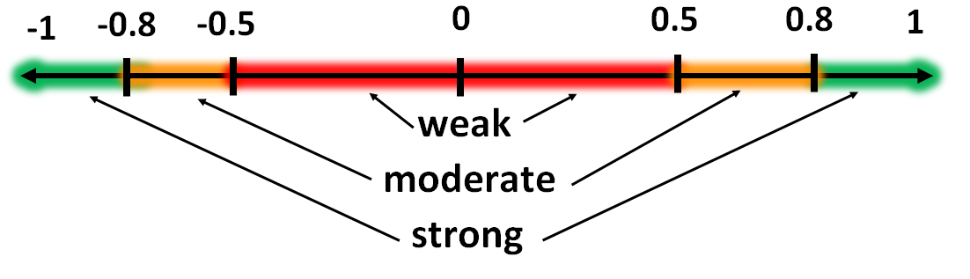
Correlation Recap
Correlation is a way to quantify the strength between two or more variables-how close two variables are to having a linear relationship with each other.
The presence of a correlation is not sufficient to infer the presence of a causal relationship (i.e. correlation does not imply causation).
The most widely used measure of correlation is the Pearson correlation coefficient which measures the linear correlation between two variables X and Y and has a value between +1 and -1.
A correlation coefficient of +1 indicates a perfect positive linear relationship, and a correlation coefficient of -1 indicates a perfect negative relationship.
420-TT3-UM - Data Visualization and Reporting Tool | Montreal College IT

Slide 78
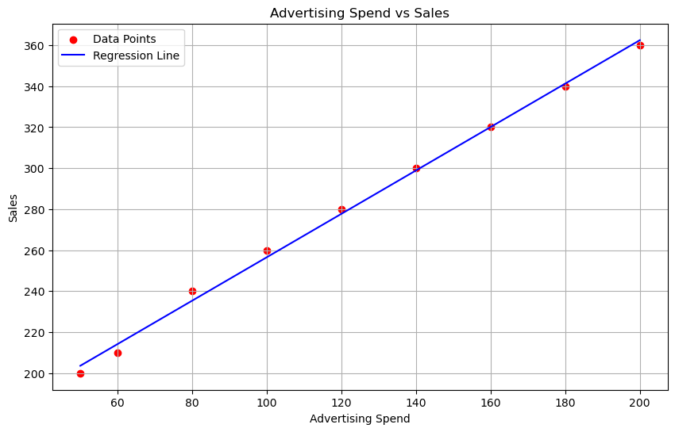
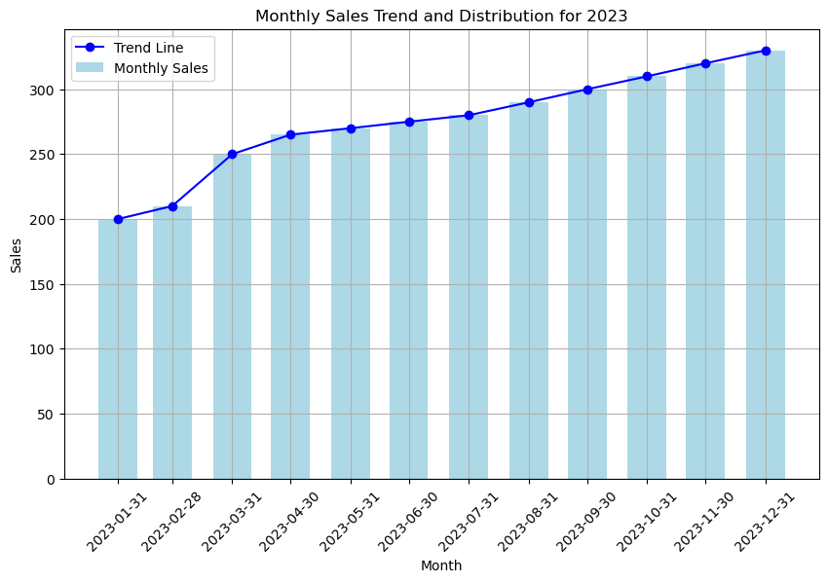
Regression vs. Trend
Regression line is a statistics concept where we try to explain the dependent variables based on variation in independent variables for a given set of data points.
Regression is a relationship between two variables.
Trend line is a straight line indicating the direction of a process with respect to time.
Trend is a time series concept . Trend says whether over time data is in uptrend or down-trend.
420-TT3-UM - Data Visualization and Reporting Tool | Montreal College IT

Slide 79
Standardization
Most data sets contain diverse information. The variables are typically displayed in several dimensions.
Consider the data set on the right, which contains the following variables:
Age (in years)
Annual income (in US$)
Height (in cm)
The income column has the highest range.
Age (years) | Income (US$) | Height (cm)
28 | 50000 | 175
35 | 60000 | 180
42 | 75000 | 168
31 | 55000 | 172
45 | 80000 | 185
29 | 52000 | 170
38 | 68000 | 176
33 | 62000 | 178
40 | 72000 | 173
27 | 48000 | 168
420-TT3-UM - Data Visualization and Reporting Tool | Montreal College IT

Slide 80
The Objective of Standardization
Standardization ensures that data is presented in a uniform format, making it consistent and easy to compare and analyze.
It enables data from different sources to be integrated seamlessly, allowing for more comprehensive analysis and collaboration across systems.
Age (years) | Income (US$) | Height (cm)
28 | 50000 | 175
35 | 60000 | 180
42 | 75000 | 168
31 | 55000 | 172
45 | 80000 | 185
29 | 52000 | 170
38 | 68000 | 176
33 | 62000 | 178
40 | 72000 | 173
27 | 48000 | 168
Age (years) | Income (US$) | Height (cm)
-1.088 | -1.093 | 0.092
0.032 | -0.197 | 1.007
1.152 | 1.147 | -1.190
-0.608 | -0.645 | -0.458
1.632 | 1.594 | 1.922
-0.928 | -0.914 | -0.824
0.512 | 0.520 | 0.275
-0.288 | -0.018 | 0.641
0.832 | 0.878 | -0.275
-1.248 | -1.272 | -1.190
420-TT3-UM - Data Visualization and Reporting Tool | Montreal College IT

Slide 81
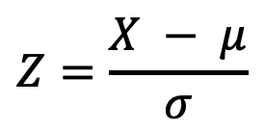
How Does Standardization Work?
Calculate Mean and Standard Deviation: First, calculate the mean and standard deviation of the column (or field or feature or variable or attribute) you want to standardize.
Subtract the Mean: For each data point, subtract the mean value from it.
Divide by Standard Deviation: After subtracting the mean, divide each data point by the standard deviation.
Resulting Z-Scores: The values you obtain after these calculations are called Z-scores or standard scores.
$$Z=\frac{X − μ}{σ}$$
420-TT3-UM - Data Visualization and Reporting Tool | Montreal College IT

Slide 82
Example of Standardization
Step 1: Calculate mean and Std. for each field
Age (years) | Income (US$) | Height (cm)
28 | 50000 | 175
35 | 60000 | 180
42 | 75000 | 168
31 | 55000 | 172
45 | 80000 | 185
29 | 52000 | 170
38 | 68000 | 176
33 | 62000 | 178
40 | 72000 | 173
27 | 48000 | 168
Age (years) | Income (US$) | Height (cm)
28 | 50000 | 175
35 | 60000 | 180
42 | 75000 | 168
31 | 55000 | 172
45 | 80000 | 185
29 | 52000 | 170
38 | 68000 | 176
33 | 62000 | 178
40 | 72000 | 173
27 | 48000 | 168
34.80 | 62200.00 | 174.50
6.25 | 11163.43 | 5.46
Step 1
Mean
Std. Dev
420-TT3-UM - Data Visualization and Reporting Tool | Montreal College IT

Slide 83
Example of Standardization
Step 2: Subtract Mean from each data point
Age (years) | Income (US$) | Height (cm)
28 | 50000 | 175
35 | 60000 | 180
42 | 75000 | 168
31 | 55000 | 172
45 | 80000 | 185
29 | 52000 | 170
38 | 68000 | 176
33 | 62000 | 178
40 | 72000 | 173
27 | 48000 | 168
34.80 | 62200.00 | 174.50
6.25 | 11163.43 | 5.46
Age (years) | Income (US$) | Height (cm)
-6.80 | -12200.00 | 0.50
0.20 | -2200.00 | 5.50
7.20 | 12800.00 | -6.50
-3.80 | -7200.00 | -2.50
10.20 | 17800.00 | 10.50
-5.80 | -10200.00 | -4.50
3.20 | 5800.00 | 1.50
-1.80 | -200.00 | 3.50
5.20 | 9800.00 | -1.50
-7.80 | -14200.00 | -6.50
0.00 | 0.00 | 0.00
6.25 | 11163.43 | 5.46
Step 2
420-TT3-UM - Data Visualization and Reporting Tool | Montreal College IT

Slide 84
Example of Standardization
Step 3: Divide each data point by Std.
Age (years) | Income (US$) | Height (cm)
-6.80 | -12200.00 | 0.50
0.20 | -2200.00 | 5.50
7.20 | 12800.00 | -6.50
-3.80 | -7200.00 | -2.50
10.20 | 17800.00 | 10.50
-5.80 | -10200.00 | -4.50
3.20 | 5800.00 | 1.50
-1.80 | -200.00 | 3.50
5.20 | 9800.00 | -1.50
-7.80 | -14200.00 | -6.50
0.00 | 0.00 | 0.00
6.25 | 11163.43 | 5.46
Age (years) | Income (US$) | Height (cm)
-1.088 | -1.093 | 0.092
0.032 | -0.197 | 1.007
1.152 | 1.147 | -1.190
-0.608 | -0.645 | -0.458
1.632 | 1.594 | 1.922
-0.928 | -0.914 | -0.824
0.512 | 0.520 | 0.275
-0.288 | -0.018 | 0.641
0.832 | 0.878 | -0.275
-1.248 | -1.272 | -1.190
0.00 | 0.00 | 0.00
1.00 | 1.00 | 1.00
Step 3
Standardized values or
Z-scores
420-TT3-UM - Data Visualization and Reporting Tool | Montreal College IT

Slide 85
Interpreting the Z-Scores
Key benefits of using standardization:
Consistency: Standardization ensures that data is presented in a uniform format.
Interoperability: It enables seamless integration of data from different sources.
Data Accuracy: Standardization reduces errors and inaccuracies arising from varying units or formats.
Efficiency: Standardized data streamlines data preparation.
Age (years) | Income (US$) | Height (cm)
-1.088 | -1.093 | 0.092
0.032 | -0.197 | 1.007
1.152 | 1.147 | -1.190
-0.608 | -0.645 | -0.458
1.632 | 1.594 | 1.922
-0.928 | -0.914 | -0.824
0.512 | 0.520 | 0.275
-0.288 | -0.018 | 0.641
0.832 | 0.878 | -0.275
-1.248 | -1.272 | -1.190
0.00 | 0.00 | 0.00
1.00 | 1.00 | 1.00
420-TT3-UM - Data Visualization and Reporting Tool | Montreal College IT

Slide 86
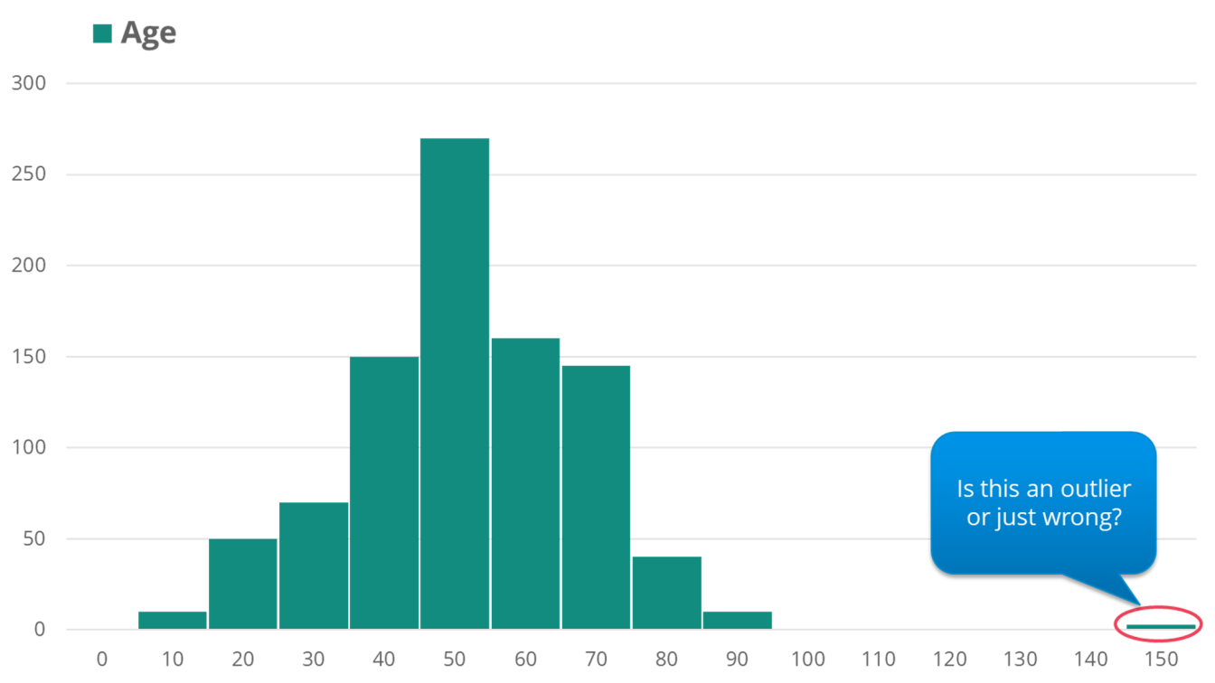
Outlier Detection
Outliers are data points significantly different from the rest of the dataset. They can be exceptionally high or low values or data points that exhibit unusual patterns.
Detecting outliers is crucial because they can distort statistical analyses, machine learning models, and data visualization.
420-TT3-UM - Data Visualization and Reporting Tool | Montreal College IT

Slide 87
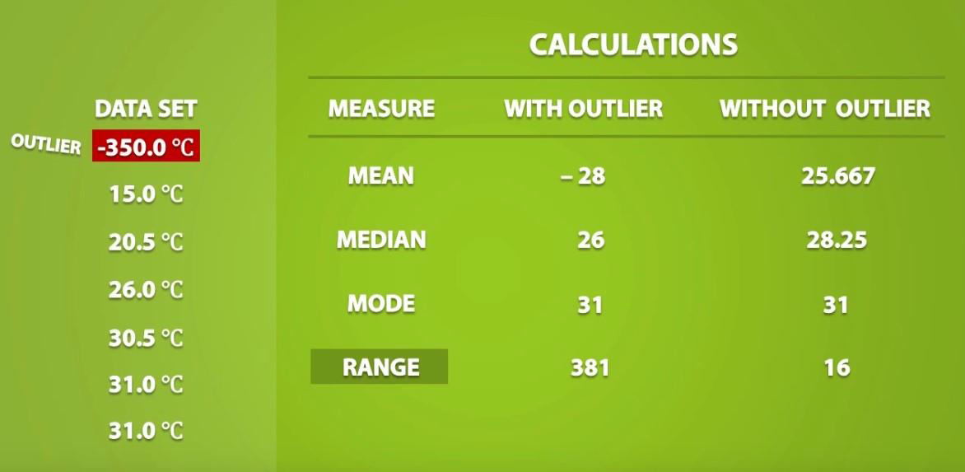
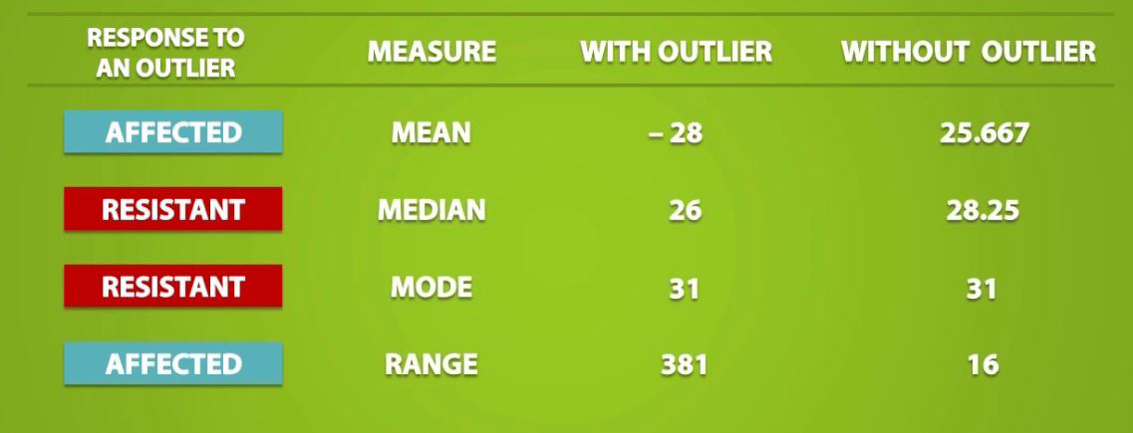
Outlier Detection
420-TT3-UM - Data Visualization and Reporting Tool | Montreal College IT

Slide 88
Outlier Detection Methods
There are different ways to detect outliers in data sets:
Statistical Approaches
Z-Score
IQR
2. Machine Learning Algorithms
Isolation Forests
One-Class SVM
3. Visual Techniques
Scatter Plots
Box Plots
420-TT3-UM - Data Visualization and Reporting Tool | Montreal College IT

Slide 89
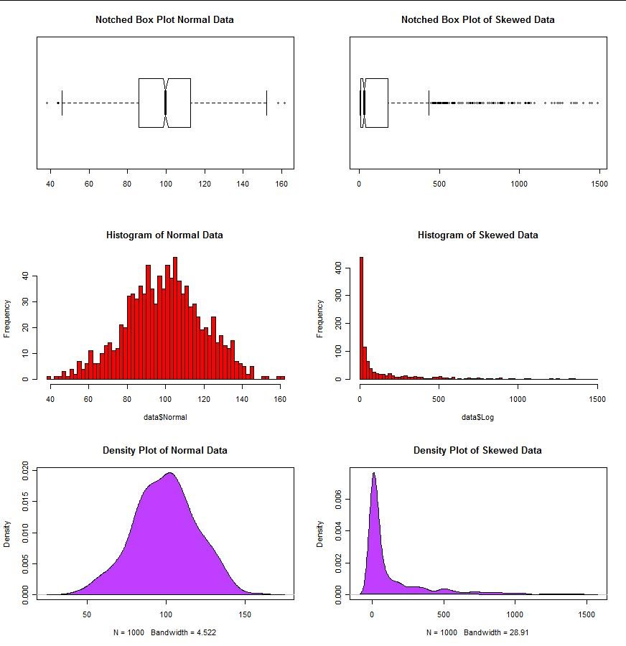
Outlier Detection Methods (Box plot)
A box plot displays the summary of a set of data values having properties like minimum, first quartile, median, third quartile, and maximum.
Outliers in a box plot are typically indicated by points that lie outside the whiskers, which are 1.5 times the interquartile range (IQR) from the lower and upper quartiles.
420-TT3-UM - Data Visualization and Reporting Tool | Montreal College IT

Slide 90
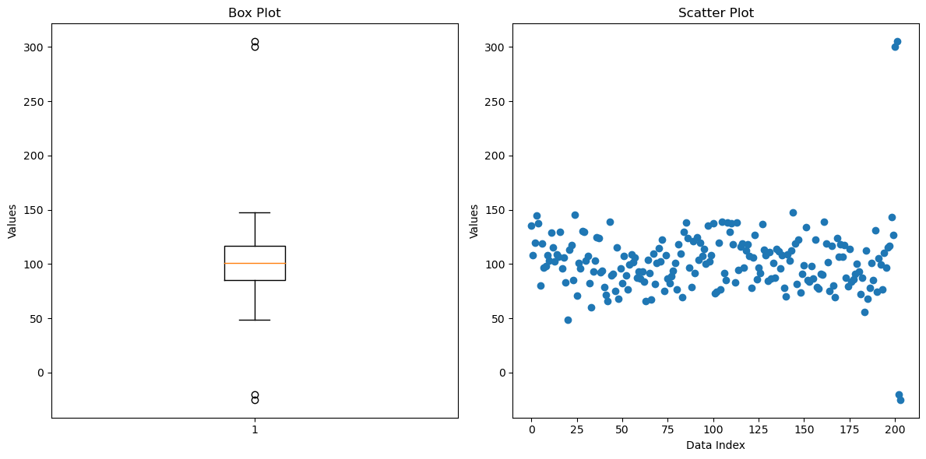
Outlier Detection Methods (Scatter plot)
A scatter plot shows all individual data points on a two-dimensional graph, making it easy to spot where the points cluster and where they do not.
Outliers in a scatter plot are points that are significantly distant from the main cluster of data. They don’t follow the trend set by the majority of the points.
420-TT3-UM - Data Visualization and Reporting Tool | Montreal College IT

Slide 91
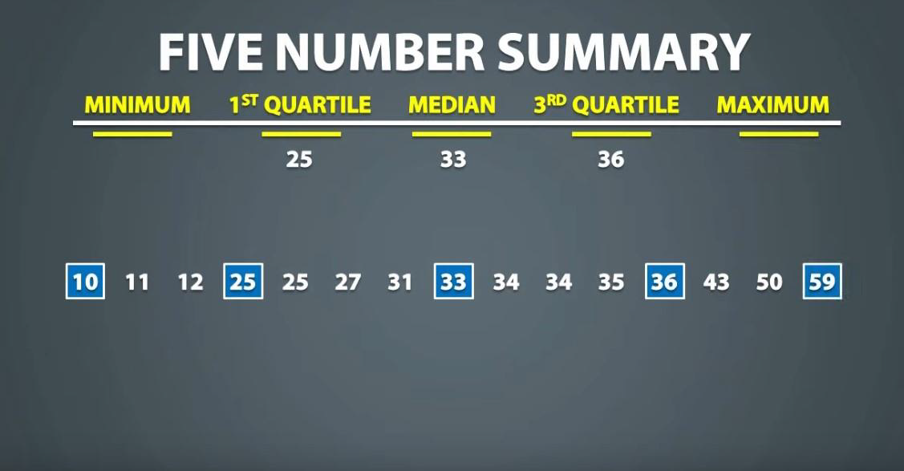
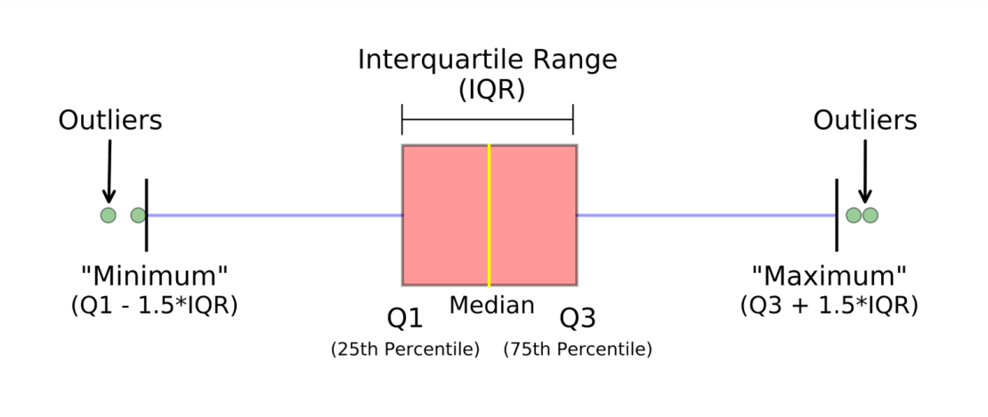
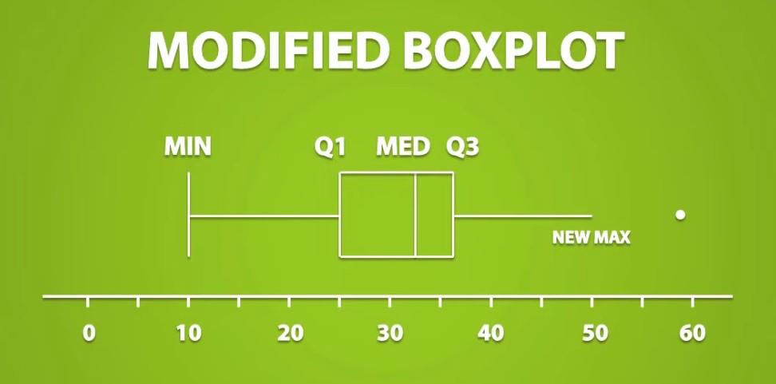
Outlier Detection Methods (IQR)
420-TT3-UM - Data Visualization and Reporting Tool | Montreal College IT

Slide 92
Outlier Detection Methods (IQR)
Outliers are typically defined as observations that fall below Q1 – (1.5 * IQR) or above
Q3 + (1.5 * IQR).
420-TT3-UM - Data Visualization and Reporting Tool | Montreal College IT

Slide 93
Outlier Detection Methods (Z-Score)
The Z-score tells you how many standard deviations a data point is from the mean.
A common threshold for identifying outliers is a Z-score of 1.96 or 2, which corresponds to the 95th percentile and 97.5th percentile, respectively, in a normal distribution.
Data points with a Z-score greater than 2 or less than -2 are often considered outliers.
import numpy as np
# Example data
data = np.array([10, 12, 13, 12, 11, 14, 13, 15, 102, 14, 13, 12, 10, 100])
# Calculate mean and standard deviation
mean = np.mean(data)
std_dev = np.std(data)
# Calculate Z-scores
z_scores = (data - mean) / std_dev
# Identify outliers
outliers = data[np.abs(z_scores) > 2]
420-TT3-UM - Data Visualization and Reporting Tool | Montreal College IT

Slide 94
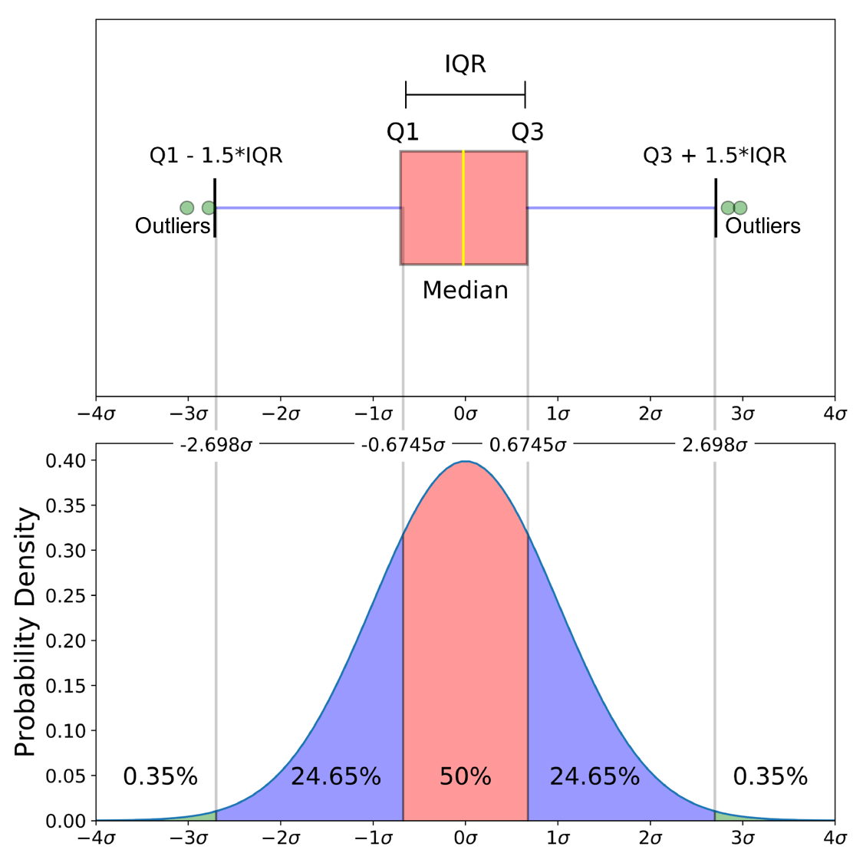
Normal Distribution and Box Plot
What do you understand from this?
420-TT3-UM - Data Visualization and Reporting Tool | Montreal College IT

Slide 95

Outlier Detection Challenges
Identifying outliers can be challenging because what constitutes an outlier may vary depending on the context.
Domain knowledge and a clear understanding of the dataset are often required to determine the appropriate handling of outliers, whether through removal, transformation, or further investigation.
420-TT3-UM - Data Visualization and Reporting Tool | Montreal College IT

Slide 96
Outlier Detection Use Cases
Outlier detection is widely used in various domains, including:
In finance, outlier detection is used for fraud detection.
In healthcare, outlier detection is used to find diseases.
In manufacturing, outlier detection is used for quality control.
In data analysis, outlier detection can be used as a pre-processing step to increase the quality of data sets.
420-TT3-UM - Data Visualization and Reporting Tool | Montreal College IT

Slide 97

Dealing With Missing Values
Missing values (denoted by NA) are one of the most common ‘flaws’ in data sets, and they are important because they might have a large impact onthe functions and formulas that you aim to use(especially in the models that are discussed in the next chapter)
Some functions have been set up to deal with missing values, whereas other functions might return errors when they need to deal with NAs.
420-TT3-UM - Data Visualization and Reporting Tool | Montreal College IT

Slide 98
Missing Values - Techniques
1. Deletion (Drop) Methods: Eliminate any row that has a missing value.
Suitable if there are only a limited number of NAs, and the data set is large enough that reducing the size has little impact on the overall results.
2. Imputation Methods: Filling in missing values with some estimated or calculated values.
Suitable if you want to keep all your observations. This will not skew the data too much because it ‘smoothens’ the observations. However, the results might become dependent on order of the rows.
Examples: constant values, mean/median/mode, forward or backward filling.
3. Model-Based Methods: Utilize certain machine learning algorithms that can inherently handle missing values.
Suitable if you are applying particular algorithms where they accurately predict missing values based on other features, especially in smaller datasets.
Examples: XGBoost, Decision Trees, Neural Networks with Data Imputation Layers
420-TT3-UM - Data Visualization and Reporting Tool | Montreal College IT

Slide 99

Missing Values - Examples
Drop
Fill
Replace
420-TT3-UM - Data Visualization and Reporting Tool | Montreal College IT

